Slide 1
UI Design and Development
+Roman Nurik +Nick Butcher

Slide 2
Agenda
Designing for Android
Layouts and resources
Tablet considerations
System UI integration
Wireframing

Slide 3
Designing for Android

Slide 4
Design for…
Touch
Interact primarily with your fingers
Expect direct manipulation
Mobile
Often on the go
Often without network connectivity
Heterogeneity
Different screen sizes and densities
Different hardware features
Different OS versions

Slide 5
Key principles
“Pictures are faster than words.”
“Only show what I need when I need it.”
“Make the important things fast.”
“Do the heavy lifting for me.”

Slide 6
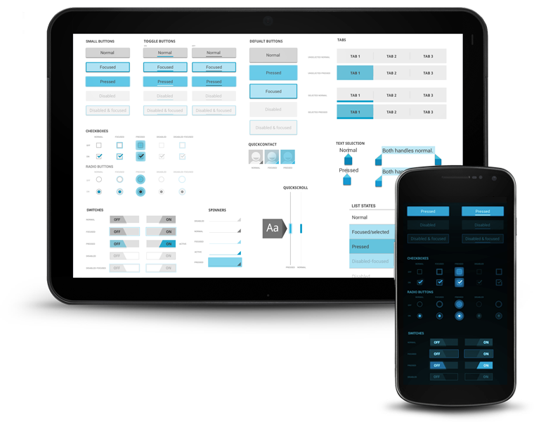
“Holo” visual language

Slide 7
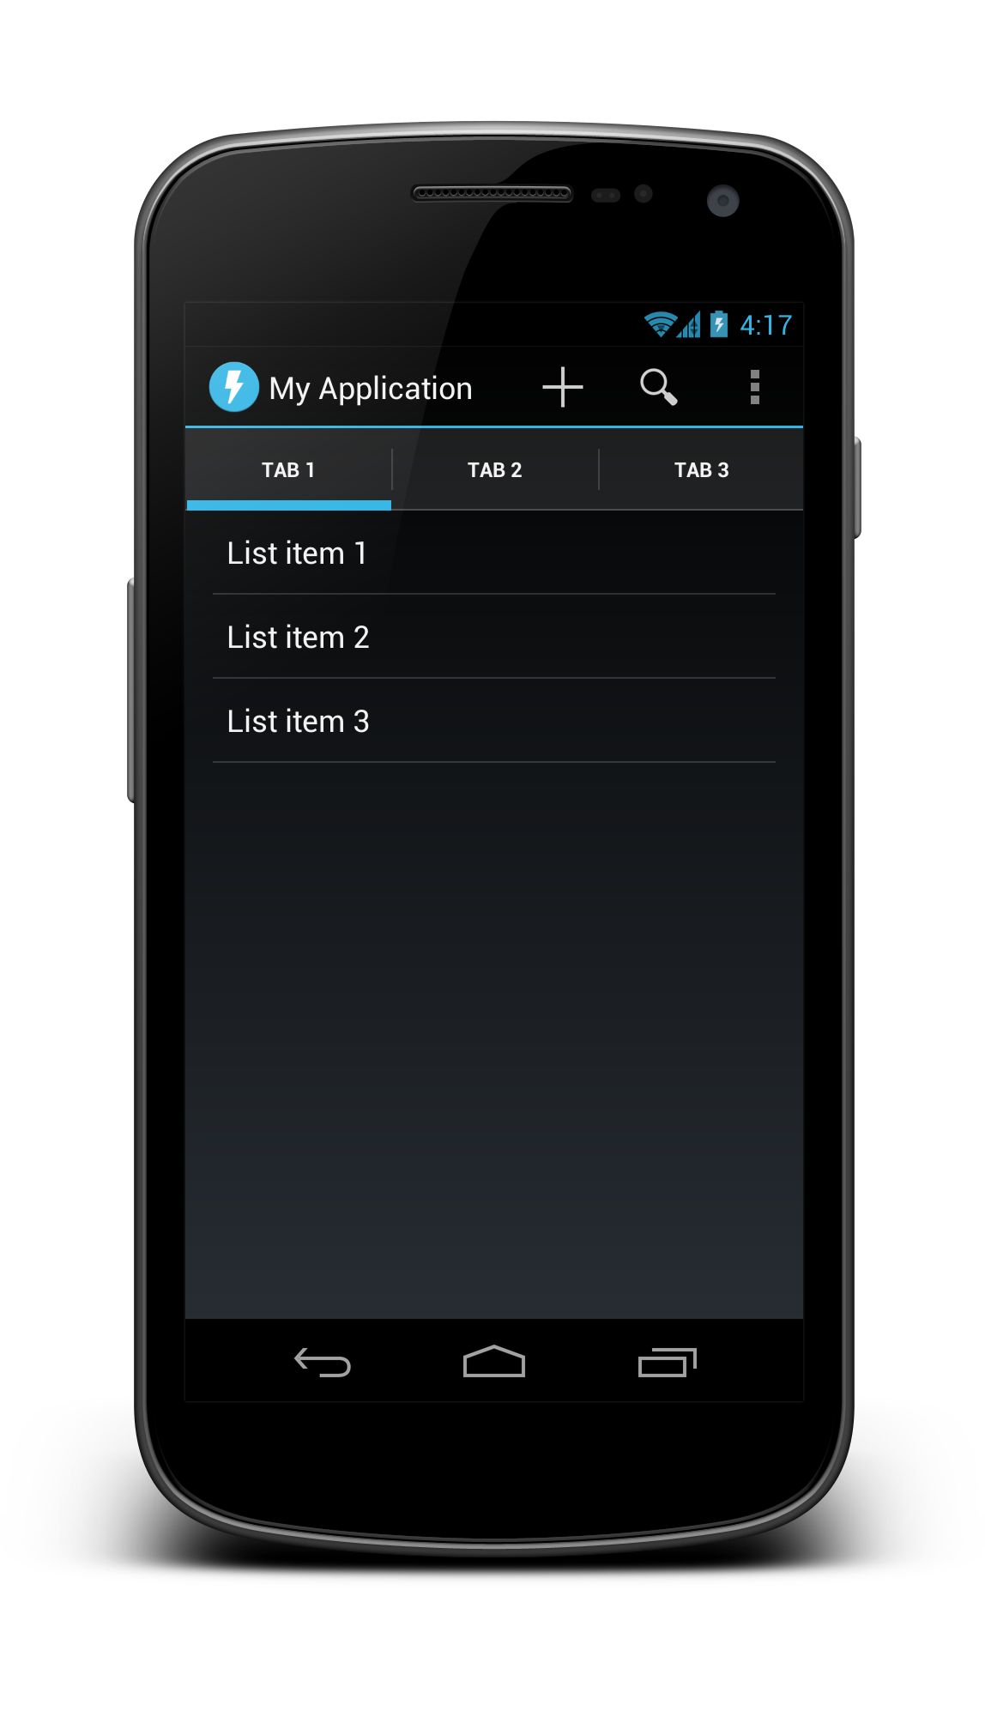
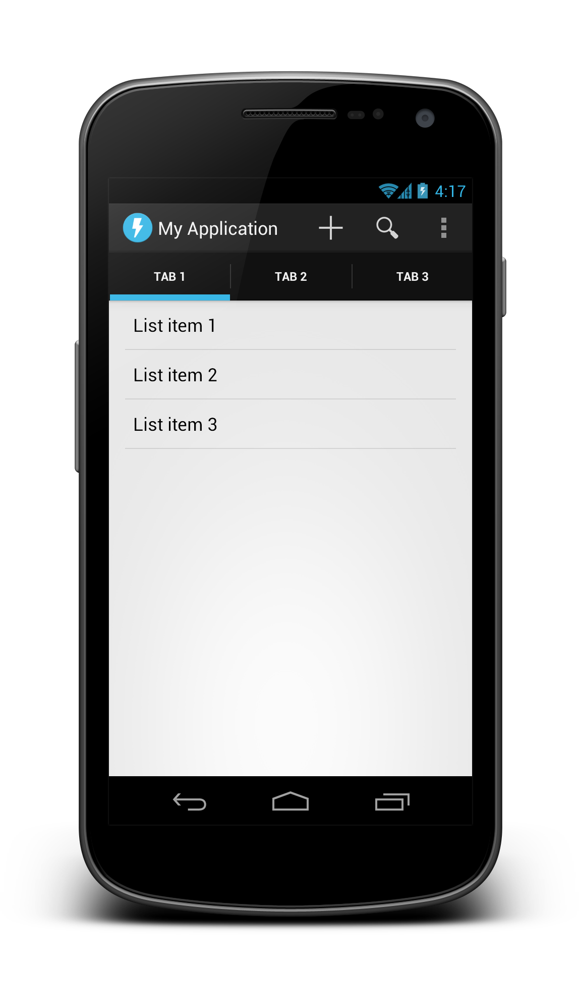
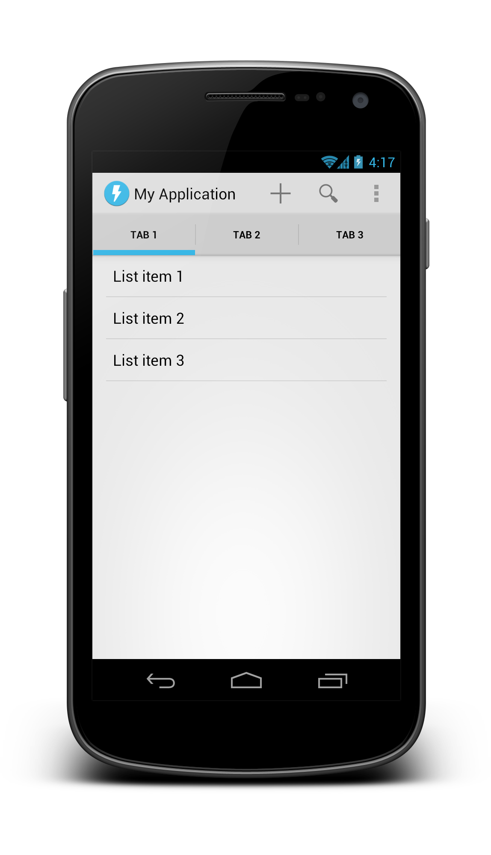
Holo variations
Dark
Dark Action Bar
Light

Slide 8
Activity UI structure
Action bar
Tabs
Content (activity layout)

Slide 9
Activity UI structure
Action bar

Slide 10
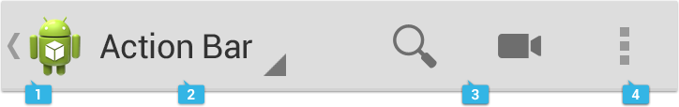
Action bar
App icon and optional Up caret
View control (Title/tabs/dropdown)
Action buttons
Action overflow

Slide 11
Action bar
Android 3.0 and above
Automatically part of Holo themes
Customize:
getActionBar().setDisplayOptions()
getActionBar().setNavigationMode()

Slide 12
Activity UI structure
Action bar

Slide 13
Activity UI structure
Tabs

Slide 14
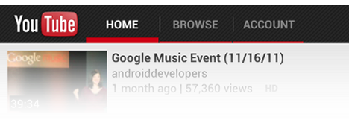
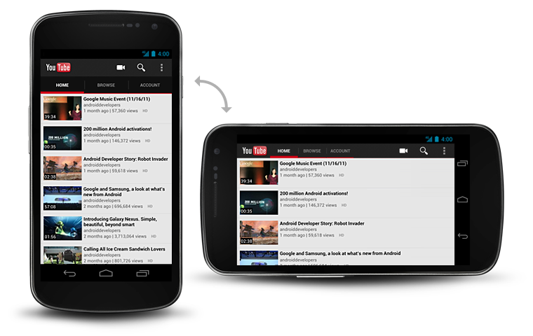
Tabs

Slide 15
Tabs
Part of the ActionBar APIs
Usually gesture-enabled using ViewPager
getActionBar().setNavigationMode(NAVIGATION_MODE_TABS);
ActionBar.Tab tab = actionBar.newTab();
tab.setText(“Tab 1”);
tab.setTabListener(this);
getActionBar().addTab(tab);

Slide 16
Activity UI structure
Tabs

Slide 17
Activity UI structure
Content (activity layout)

Slide 18
EXERCISE Create a project with an action bar and tabs

Slide 19
Layouts and resources

Slide 20
Layout system
The UI for an activity is a tree consisting of view groups and views (leaf nodes), like HTML.
Most commonly defined in XML under res/layout/.
<view group>
<view group>
<view>
<view group>
<view>
<view>

Slide 21
Views and View Groups
Views
View Groups
Reusable individual UI components
Optionally interactive (clickable/focusable/etc.)
Bare minimum functionality is to draw themselves
Ordered list of Views and View Groups
In charge of positioning and sizing their child views and layouts
Simple layouts and more complex groups (e.g. ListView)

Slide 22
Views and View Groups
Views
Layouts (simple View Groups)
TextView
EditText
Spinner
ImageView
Button
WebView
SurfaceView
Your own custom views
FrameLayout
LinearLayout
RelativeLayout
GridLayout
Your own custom layouts
Complex View Groups
ScrollView
ListView

Slide 23
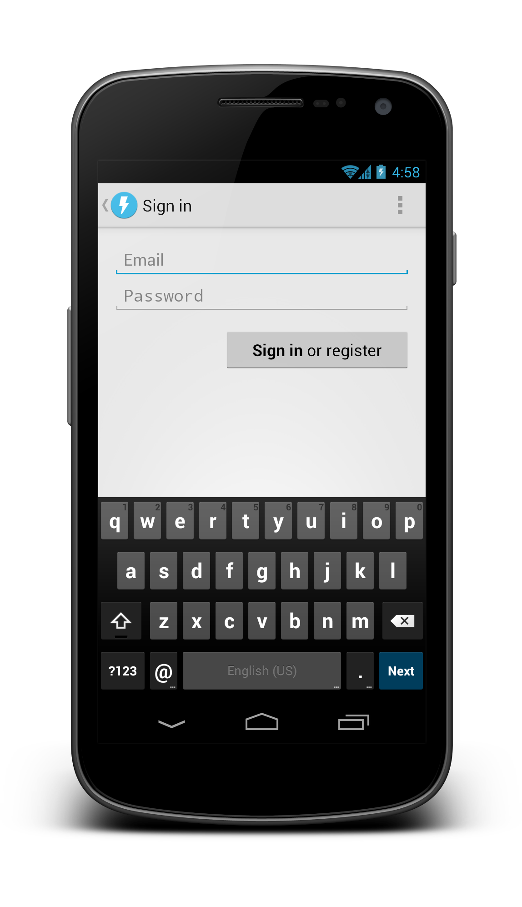
Anatomy of a simple layout

Slide 24
<LinearLayout orientation=“vertical”>
<EditText>
<Button>
<ScrollView>

Slide 25
<ScrollView
android:layout_width="match_parent"
android:layout_height="match_parent">
<LinearLayout
android:layout_width="match_parent"
android:layout_height="wrap_content"
android:orientation="vertical"
android:padding="16dp">
<EditText
android:id="@+id/email"
android:layout_width="match_parent"
android:layout_height="wrap_content"
android:hint="@string/prompt_email"
android:inputType="textEmailAddress"
android:singleLine="true" />
<EditText
android:id="@+id/password"
android:layout_width="match_parent"
android:layout_height="wrap_content"
android:hint="@string/prompt_password"
android:inputType="textPassword” android:singleLine="true" />
<Button
android:id="@+id/sign_in_button"
android:layout_width="wrap_content"
android:layout_height="wrap_content"
android:layout_gravity="right"
android:layout_marginTop="16dp"
android:paddingLeft="32dp"
android:paddingRight="32dp"
android:text="@string/action_sign_in_register" />
</LinearLayout>
</ScrollView>

Slide 26
Important layout attributes
android:layout_weight
Children of LinearLayout
android:layout_gravity
Children of FrameLayout, LinearLayout
android:gravity
TextView, LinearLayout

Slide 27
Margins and padding
android:layout_margin
Sign in or register
android:padding

Slide 28
EXERCISE Code this layout

Slide 29
Button
Button
Button
Button

Slide 30
<FrameLayout>
<LinearLayout orientation=“vertical”>
Button
Button
Button
Button
<LinearLayout orientation=“horizontal”
layout_weight=“1”>

Slide 31
Fixed header
List view
Fixed footer

Slide 32
<LinearLayout>
Fixed header
List view
<ListView layout_weight=“1”>
Fixed footer
layout_height=“wrap_content”

Slide 33
App resources
res/
drawable
drawable-xhdpi
drawable-hdpi
drawable-mdpi
layout
layout-land
layout-large
layout-large-land
One universal app binary contains all resources
System chooses at runtime which resources to use

Slide 34
res/
drawable
drawable-xhdpi
drawable-hdpi
drawable-mdpi
layout
layout-land
layout-large
layout-large-land
values
values-v11
values-v14
values-en
values-fr
values-ja
Drawable XML
PNGs, 9-patch PNGs, optimized for multiple densities
Layout XML optimized for physical screen size and orientation
Strings, styles, themes, etc.
Styles, themes varying by API level
Strings XML localized for your target regions

Slide 35
Referencing resources
A string in res/values/strings.xml
In Java: R.string.hello
In XML: @string/hello
The system “edit” icon:
In Java: android.R.drawable.ic_menu_edit
In XML: @android:drawable/ic_menu_edit

Slide 36
Referencing resources
android.R.drawable.ic_menu_edit
@android:drawable/ic_menu_edit
Namespace (either android or blank)
Resource type
Resource name

Slide 37
Screen density and DIP units
DIP units keep things the same physical size across any screen.
1 dip = 1 pixel @ MDPI (160 dpi)
1 dip = 2 pixels @ XHDPI (320 dpi)

Slide 38
Q: What is the Nexus 7’s screen resolution in DIPs if it’s 1280x800 px and 213dpi?
A: ~960x600 dip

Slide 39
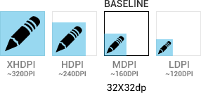
Screen density and DIP units
Icons and other PNG files should generally be provided for multiple densities

Slide 40
Key drawable types
Bitmaps (.png)
9-patches (.9.png)
State Lists (.xml)

Slide 41
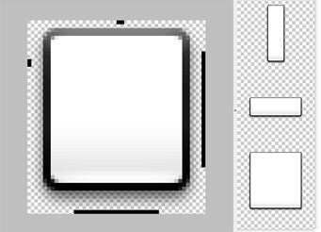
9-patches – foo.9.png
Border pixels indicate stretchable regions
Make density-specific versions (-xhdpi)

Slide 42
State list drawables
drawable/
foo.xml
<selector>
<item android:drawable="@drawable/foo_disabled"
android:state_enabled="false" ... />
<item android:drawable="@drawable/foo_pressed"
android:state_pressed="true" ... />
<item android:drawable="@drawable/foo_focused"
android:state_focused="true" ... />
<item android:drawable="@drawable/foo_default" />
</selector>

Slide 43








State list drawables
drawable-mdpi/
foo_default.png
foo_disabled.png
foo_focused.png
foo_pressed.png
drawable-hdpi/
foo_default.png
foo_disabled.png
foo_focused.png
foo_pressed.png

Slide 44
Styles
Collections of layout XML attribute values, kind of like CSS
Instead of this…
<TextView
android:layout_width="match_parent"
android:layout_height="wrap_content"
android:padding="4dp"
android:text="1" />
<TextView
android:layout_width="match_parent"
android:layout_height="wrap_content"
android:padding="4dp"
android:text="2" />

Slide 45
Styles
<TextView style="@style/MyText"
android:text="1" />
<TextView style="@style/MyText"
android:text="2" />
…use this!
res/values/
styles.xml
<style name="MyText">
<item name="android:padding">4dp</item>
<item name="android:layout_width">match_parent</item>
<item name="android:layout_height">wrap_content</item>
</style>

Slide 46
Themes
Are styles that apply to whole activities (or the entire app)
AndroidManifest.xml
<application android:theme="@android:style/Theme.Holo">
...
</application>

Slide 47
Themes
@android:style/Theme.Holo
@android:style/Theme.Holo.Light.DarkActionBar
@android:style/Theme.Holo.Light

Slide 48
Themes
Like styles, themes are extensible
<style name="MyTheme" parent="@android:style/Theme.Holo">
...
</style>

Slide 49
EXERCISE Change your app’s theme to Holo Light

Slide 50
Tablet considerations

Slide 51
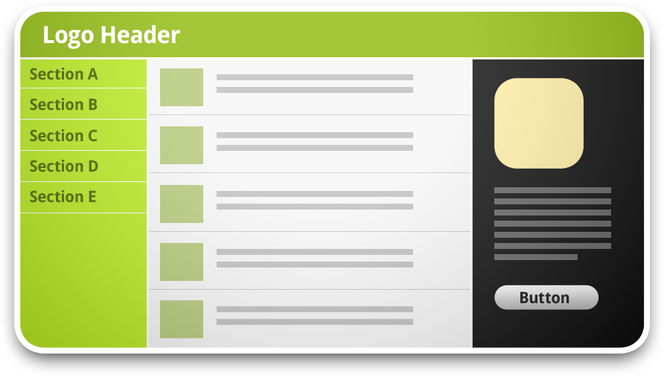
Information hierarchy and flow
Traditional desktop app or website

Slide 52
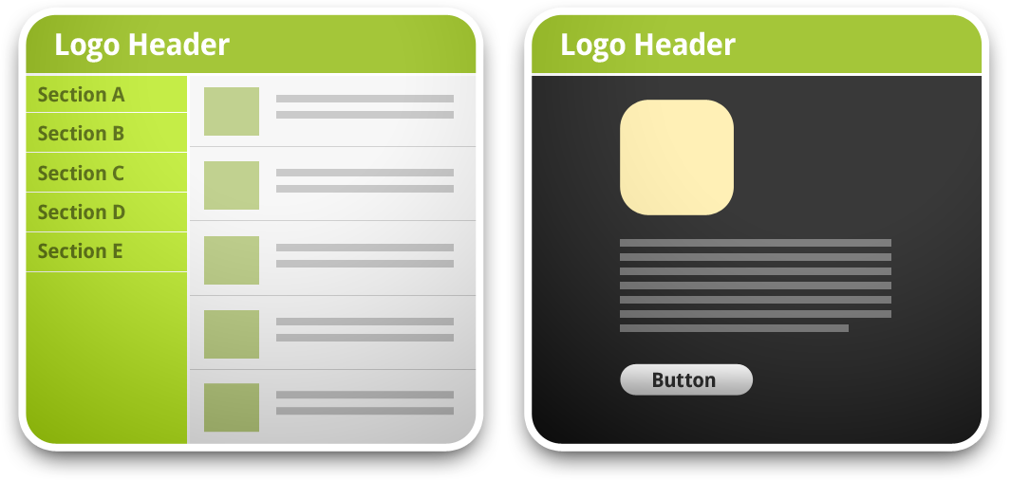
Information hierarchy and flow
Tablet or mini desktop app

Slide 53
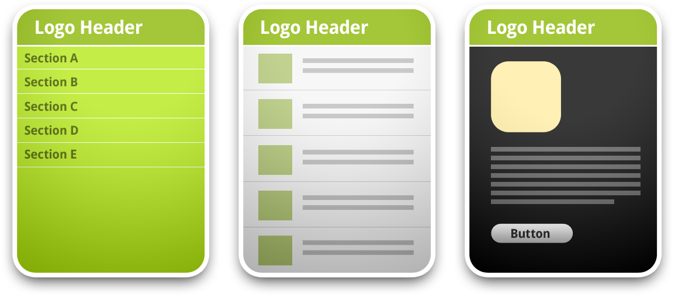
Information hierarchy and flow
Mobile phone app

Slide 54
Fragments
Separate activities into UI or code modules, each have their own class
Help with supporting phones + tablets
Each content pane is a fragment
Fragments split across activities
<fragment> in layout XML
Automatically instantiates the given fragment
Acts as a placeholder for the fragment’s view to be inserted in that part of the layout tree

Slide 55
Tablet resources
Customize layouts for large screens
Includes <fragment> tags
Incrementally increase font sizes, spacing, tweak styles
res/
layout-large/
values-large/
dimens.xml
styles.xml

Slide 56
System UI integration

Slide 57
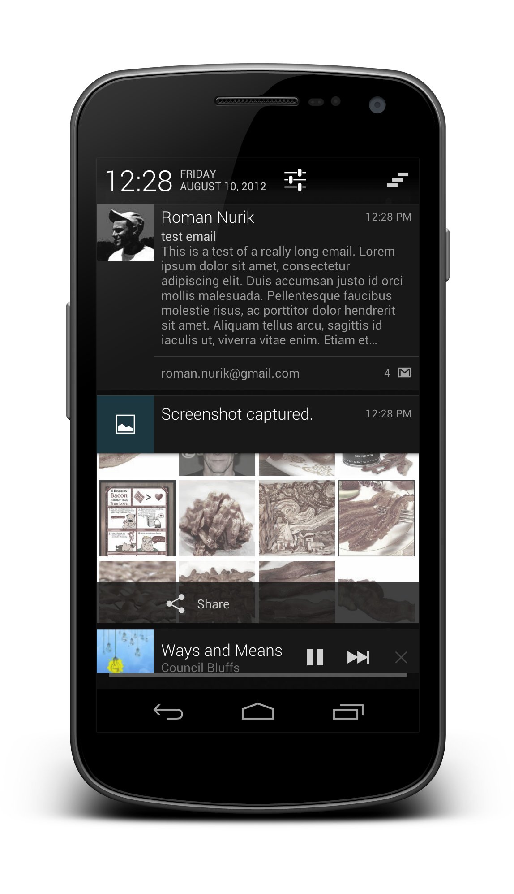
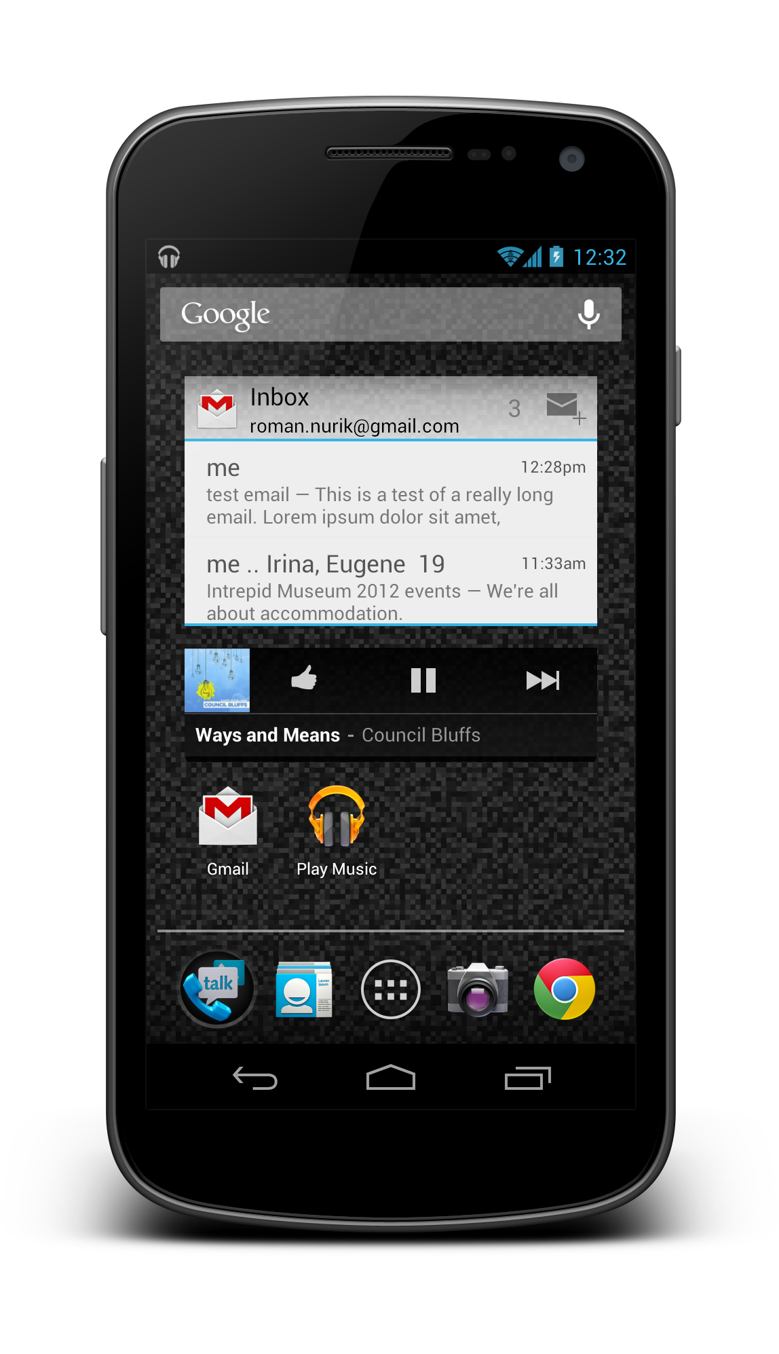
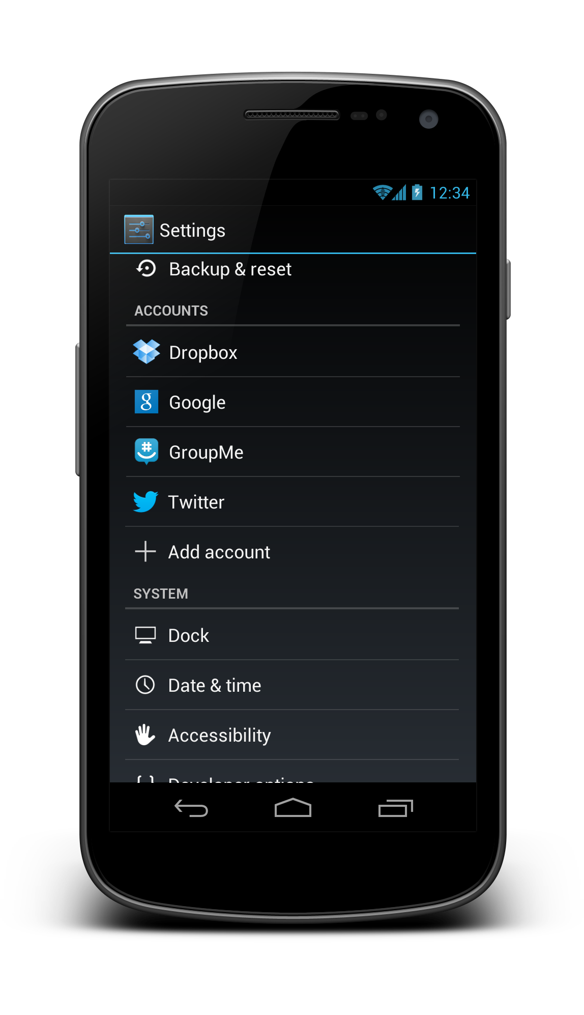
System UI integration
Notifications
App Widgets
Accounts + Sync

Slide 58

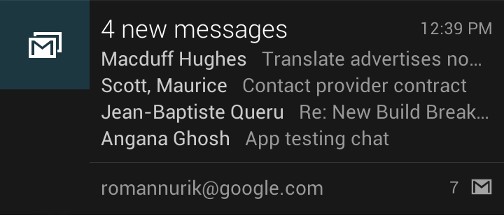
Notifications
Iconified
Collapsed
Expanded Android 4.1+

Slide 59
Notifications
Interactive

Slide 60
Notifications
Created with NotificationManager and Notification.Builder()
Custom layouts with RemoteViews
Your layouts, used in a different process
Interaction is handled entirely using intents

Slide 61
App widgets
Scrollable
Resizable
Interactive

Slide 62
App widgets
Defined in your manifest as a receiver
Handles the APPWIDGET_UPDATE intent action
Metadata provided in res/xml/widgetinfo.xml and referenced in manifest
Layout using RemoteViews
Your layouts, used in a different process
Interaction is handled entirely using intents

Slide 63
EXERCISE Show a notification in your project

Slide 64
Wireframing

Slide 65
Why create wireframes?
Record your ideas and asses their real-world feasibility
Test your your ideas and rapidly iterate
See which work and which don’t, evolve them
Map out user flow and activity diagrams
Re-arrange/add/remove interactions quickly
Scope UI complexity
Plan out intra-app “Intent-based API”

Slide 66
Wireframing before coding saves you time.

Slide 67
Wireframing tools
Time/Effort
Photoshop
OmniGraffle (Mac)
Fireworks
Keynote/Powerpoint
Fluid UI
Balsamiq
Pencil (Firefox addon)
Eclipse Layout Editor
Wireframe Sketcher
Pen + Paper
Fidelity

Slide 68
Wireframing tools
Time/Effort
Interactive
wireframes
Photoshop
OmniGraffle (Mac)
Fireworks
Keynote/Powerpoint
Fluid UI
Balsamiq
Pencil (Firefox addon)
Eclipse Layout Editor
Wireframe Sketcher
Pen + Paper
Fidelity

Slide 69
Wireframing tools
Time/Effort
Photoshop
OmniGraffle (Mac)
Fireworks
Recommended
tools
Keynote/Powerpoint
Fluid UI
Balsamiq
Pencil (Firefox addon)
Eclipse Layout Editor
Wireframe Sketcher
Pen + Paper
Fidelity

Slide 70
Always start with pencil and paper. (or a whiteboard)

Slide 71
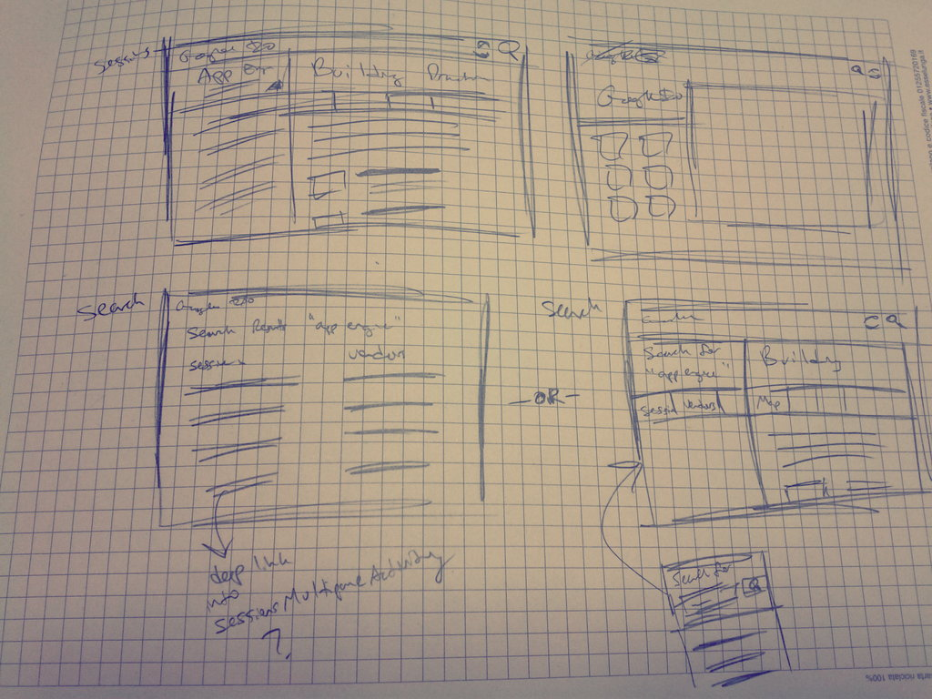
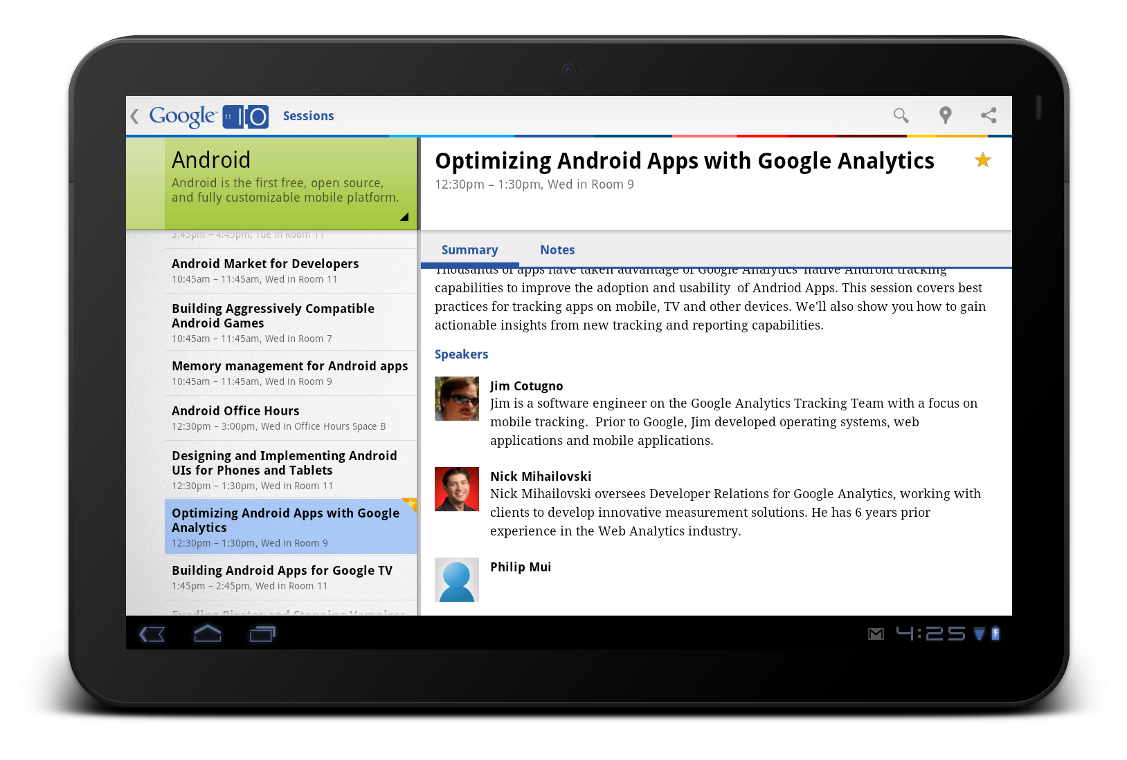
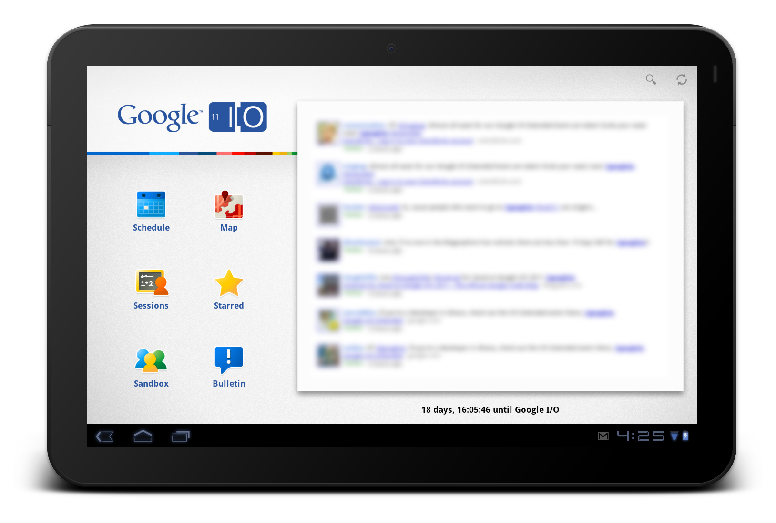

Slide 72
EXERCISE Sketch a todo list app

